Slide 1
CHAPTER 3 BASICS OF LEARNING THEORY

Slide 2
LEARNING THEORY
Learning is a process by which one can acquire knowledge and construct
new ideas or concepts based on the experiences.
The standard definition of learning proposed by Tom Mitchell is that a
program can learn from E for the task T, and P improves with experience E.
There are two kinds of problems – well-posed and ill-posed.
Computers can solve only well- posed problems, as these have well-
defined specifications and have the following components inherent to it.

Slide 3
LEARNING THEORY
Class of learning tasks (T)
A measure of performance (P)
3. A source of experience (E) Let x- input, χ-input space, Y –is the output
space. Which is the set of all possible outputs, that is yes/no,
Let D –dataset for n inputs.Consider, target function be: χ-> Y , that maps input to output.
Objective: To pick a function, g: χ-> Y to appropriate hypothesis f.

Slide 4
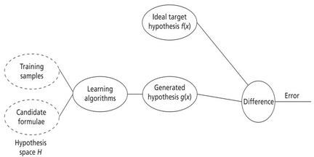
INTRODUCTION TO LEARNING AND ITS TYPES
Fig: Learning Environment
Learning model= Hypothesis set + Learning algorithm

Slide 5
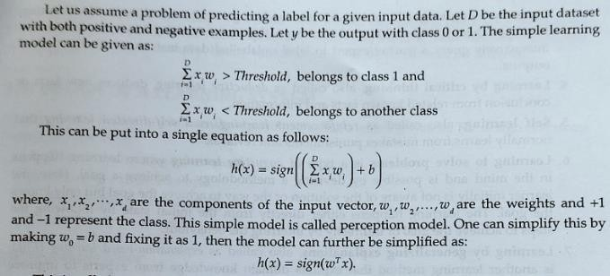

Slide 6
Classical and Adaptive ML systems.
1. Classic machines examine data inputs according to a predetermined set of
rules, finding patterns and relationships that can be used to generate
predictions or choices.
Support vector machines, decision trees, and logistic regression are some of the
most used classical machine learning techniques.
Adaptive or deep learning, is created to automatically learn from data inputs
without being explicitly programmed.
By learning hierarchical representations of the input, these algorithms are able to handle more complex and unstructured data, such as photos, videos, and natural language.
Adaptive ML is the next generation of traditional ML – the new, the improved,
the better.
Even though traditional ML witnessed significant progress.

Slide 7
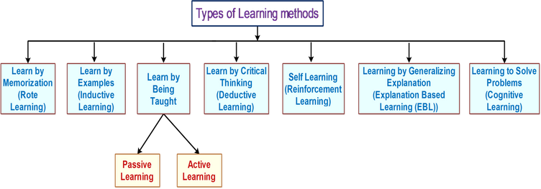

Slide 8
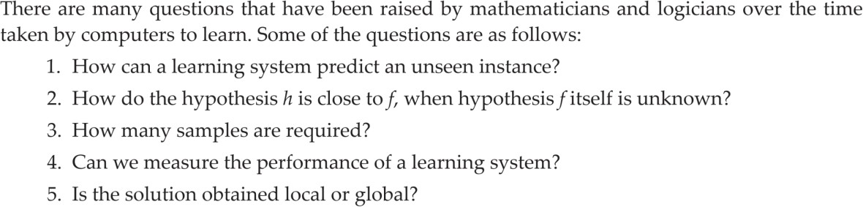
3.2 INTRODUCTION TO COMPUTATION LEARNING THEORY
These questions are the basis of a field called ‘Computational Learning Theory’ or in short
(COLT).

Slide 9
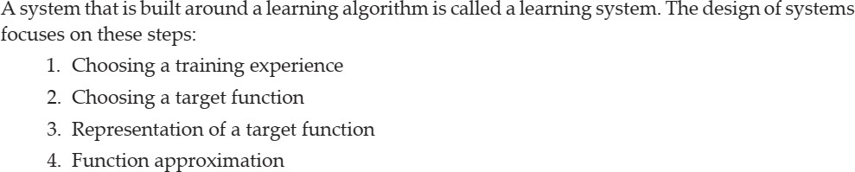
3.3 DESIGN OF A LEARNING SYSTEM

Slide 10
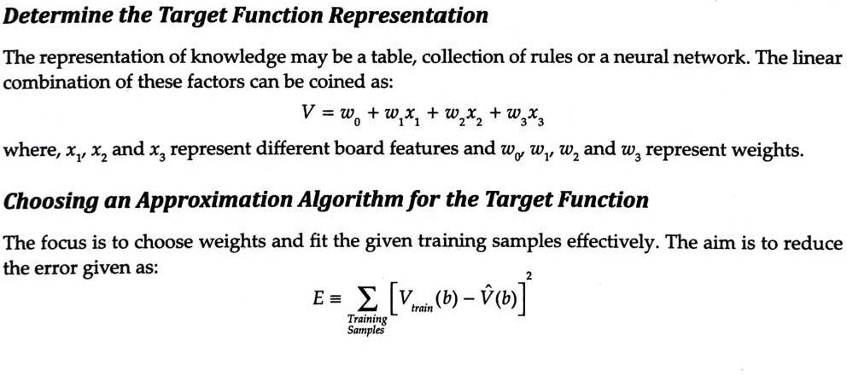
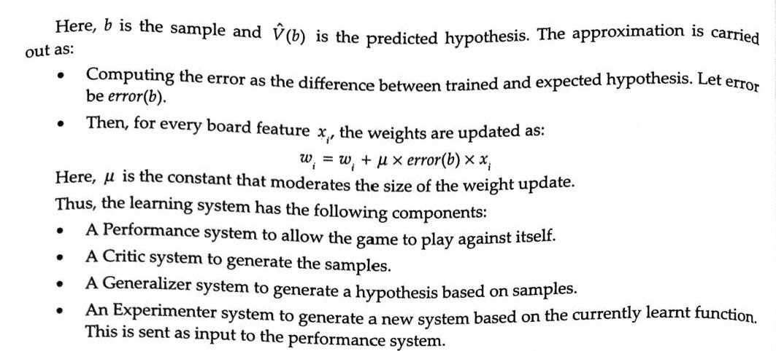

Slide 11
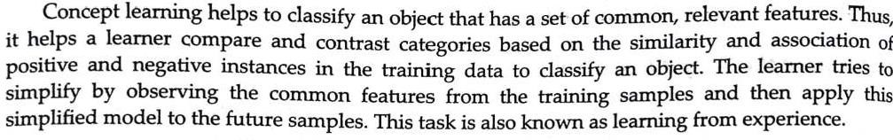
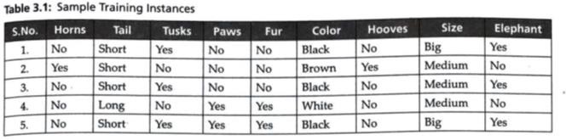
INTRODUCTION TO CONCEPT LEARNING

Slide 12
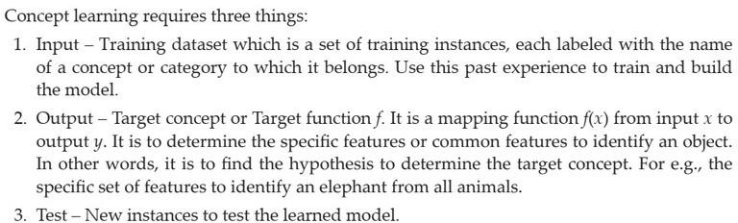
3.4 INTRODUCTION TO CONCEPT LEARNING

Slide 13
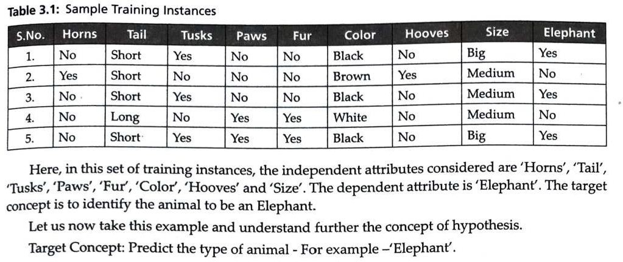

Slide 14
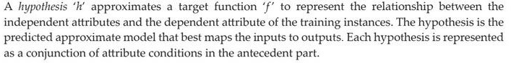
3.4.1 Representation of a Hypothesis

Slide 15
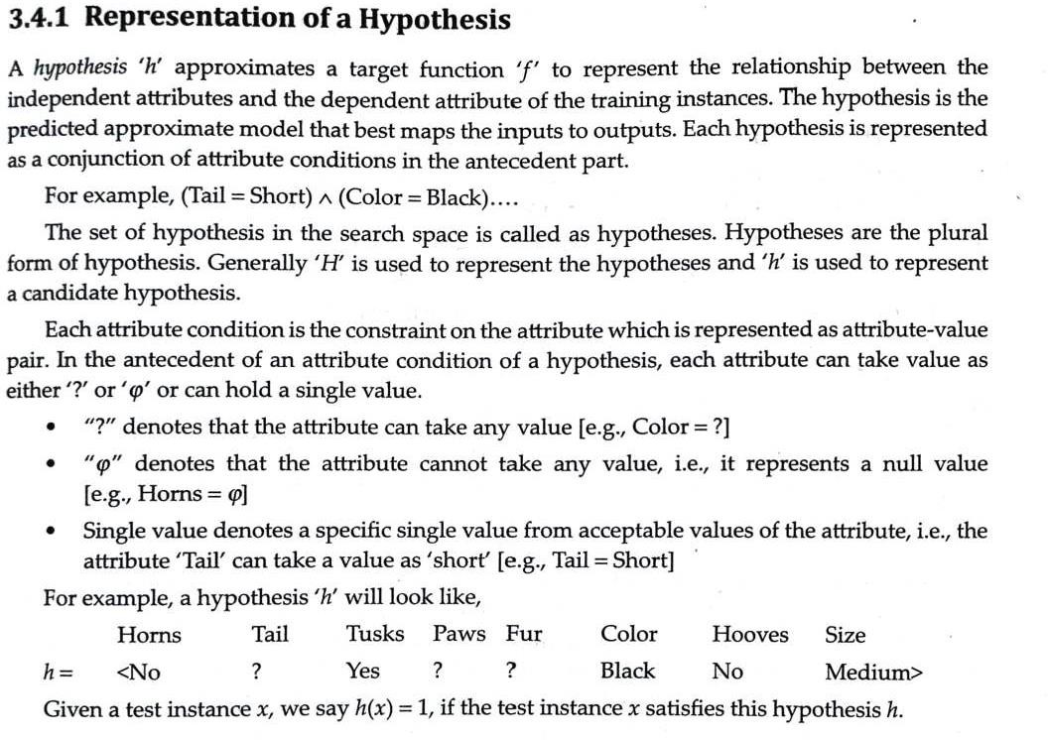

Slide 16
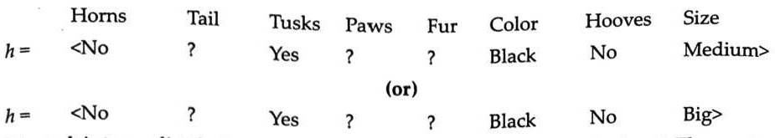
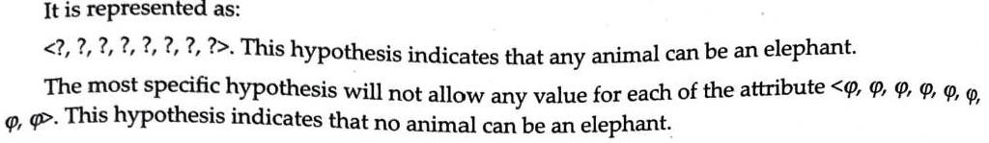

Slide 17
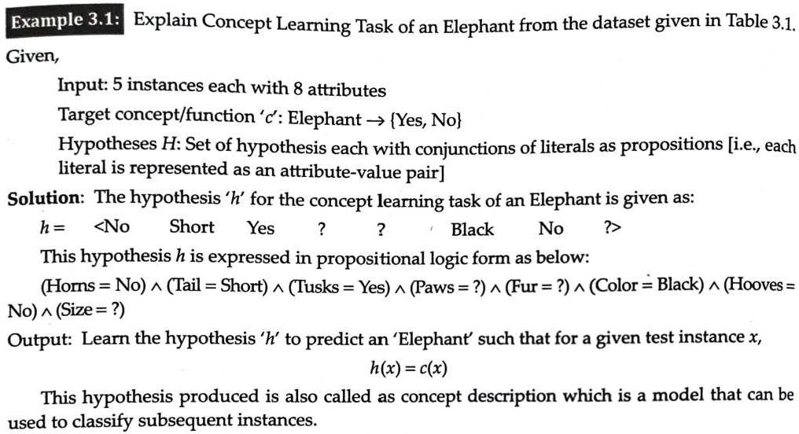

Slide 18
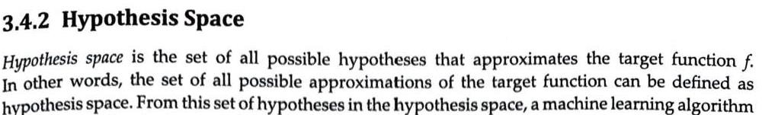
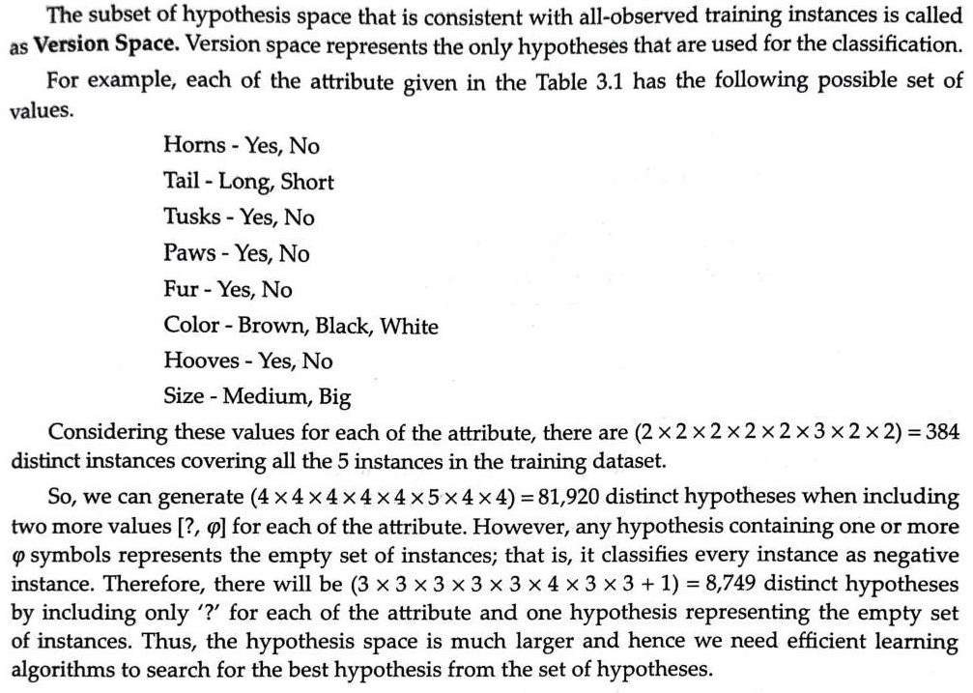

Slide 19
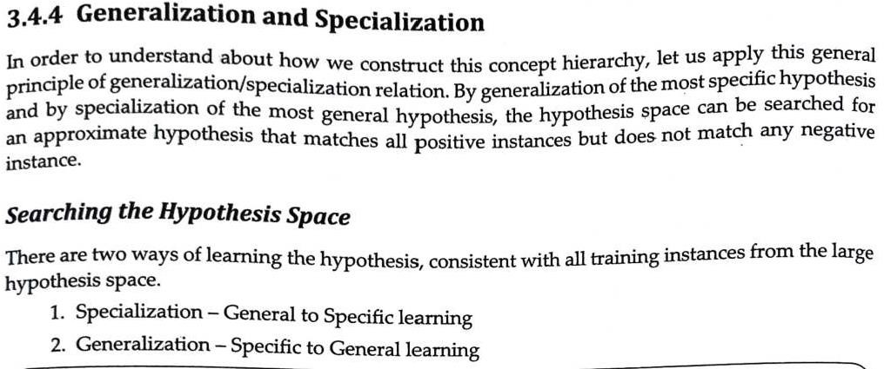

Slide 20
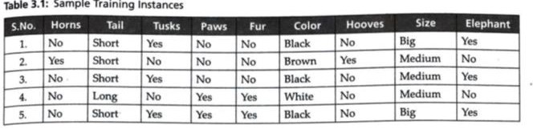
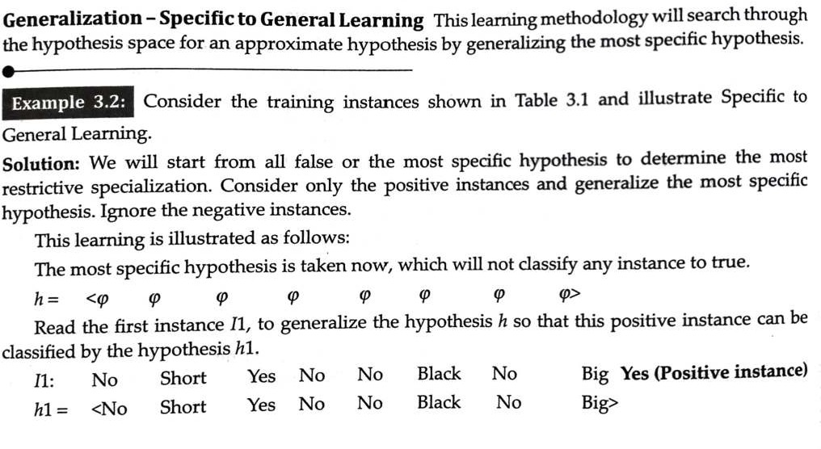

Slide 21
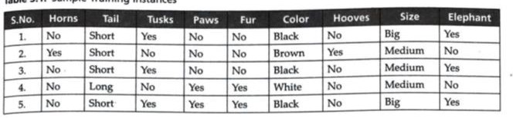
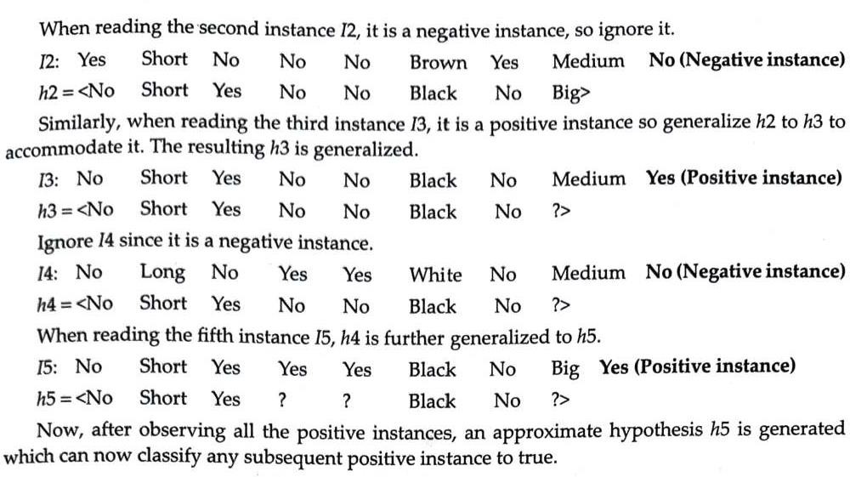

Slide 22
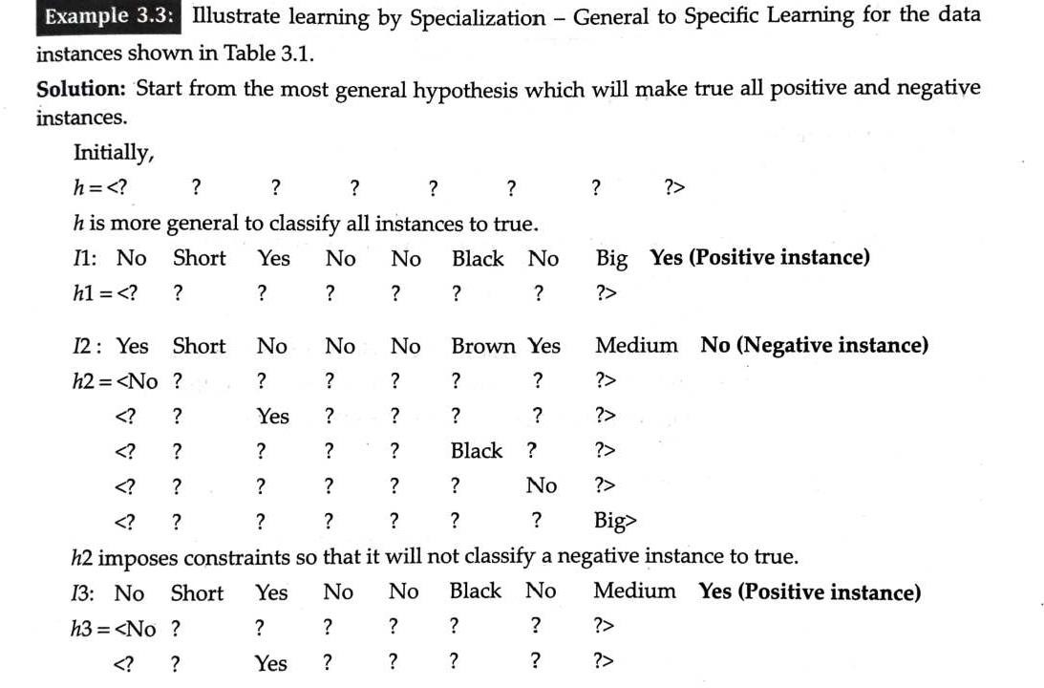
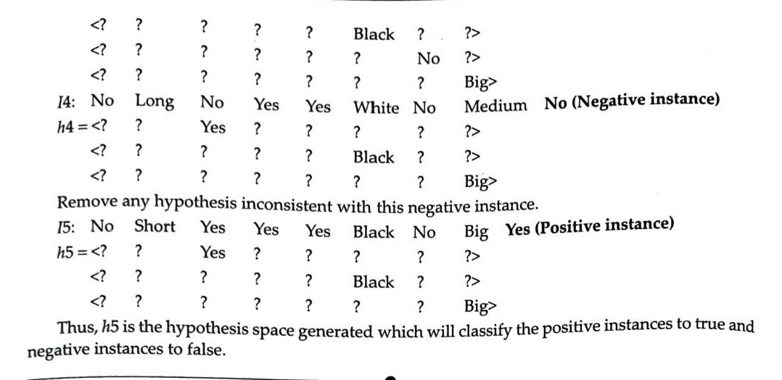

Slide 23
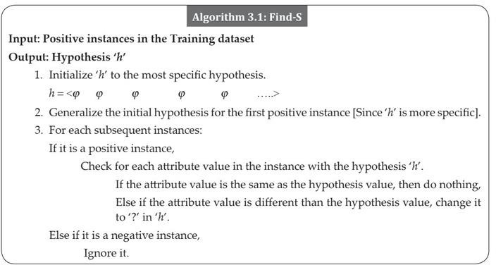

Slide 24
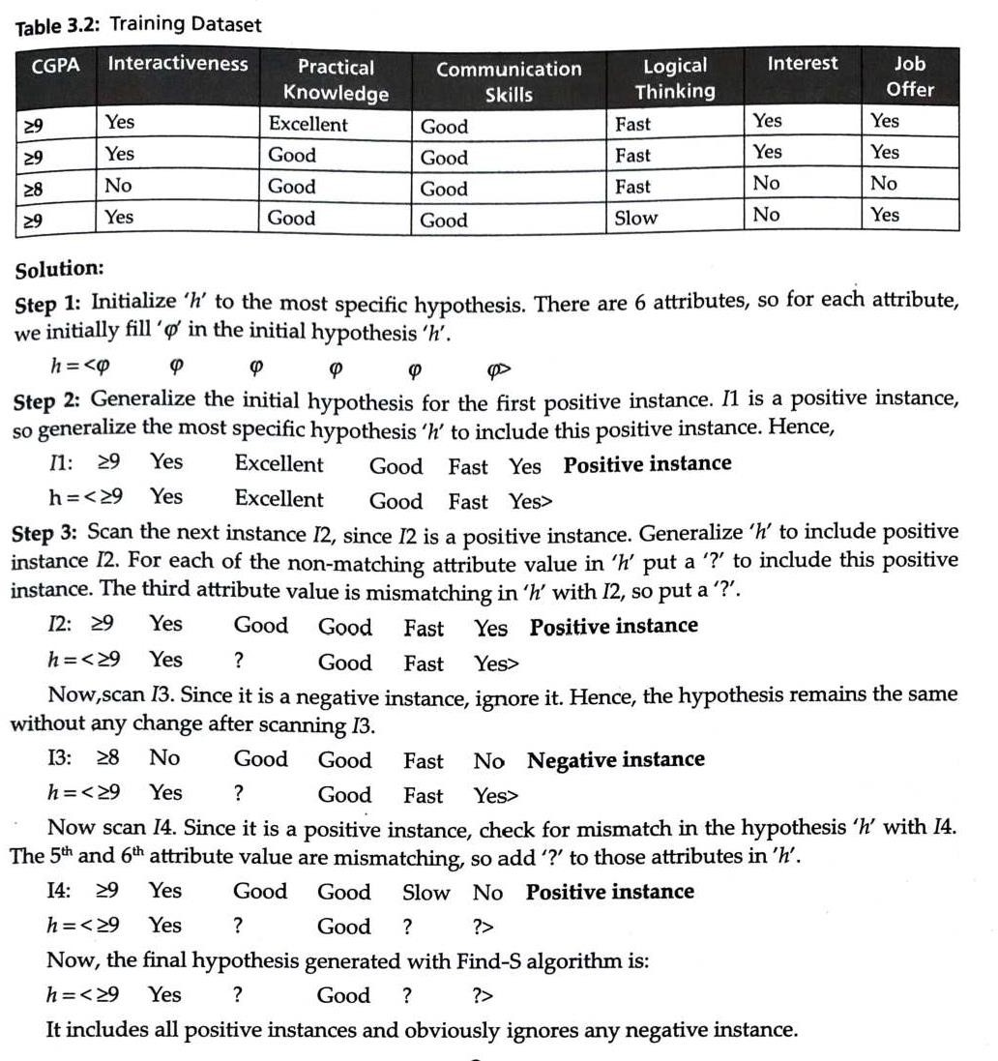

Slide 25
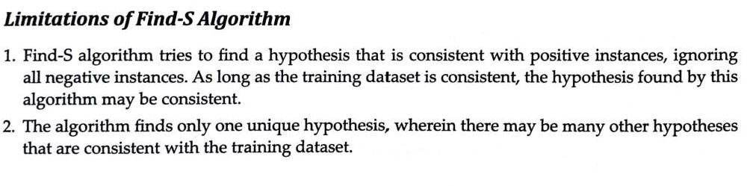

Slide 26
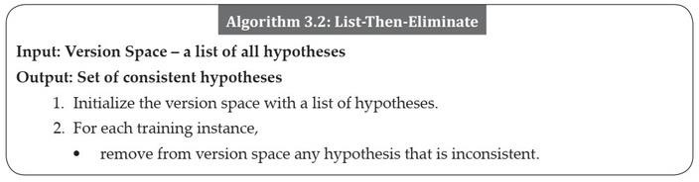
List-Then-Eliminate

Slide 27
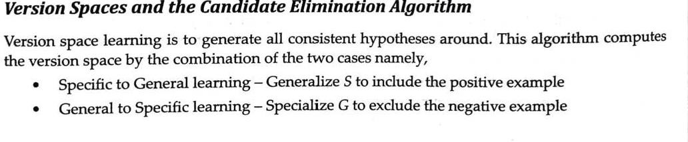

Slide 28
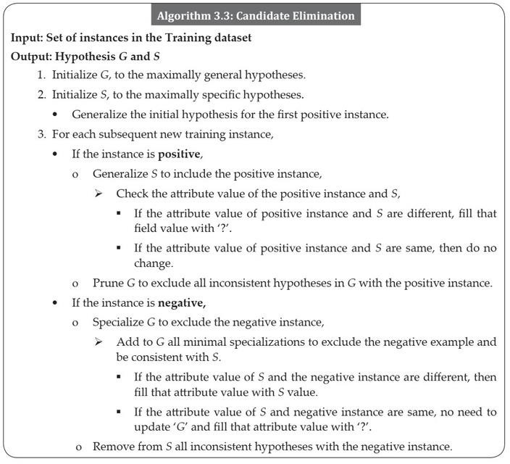
Candidate Elimination Algorithm

Slide 29
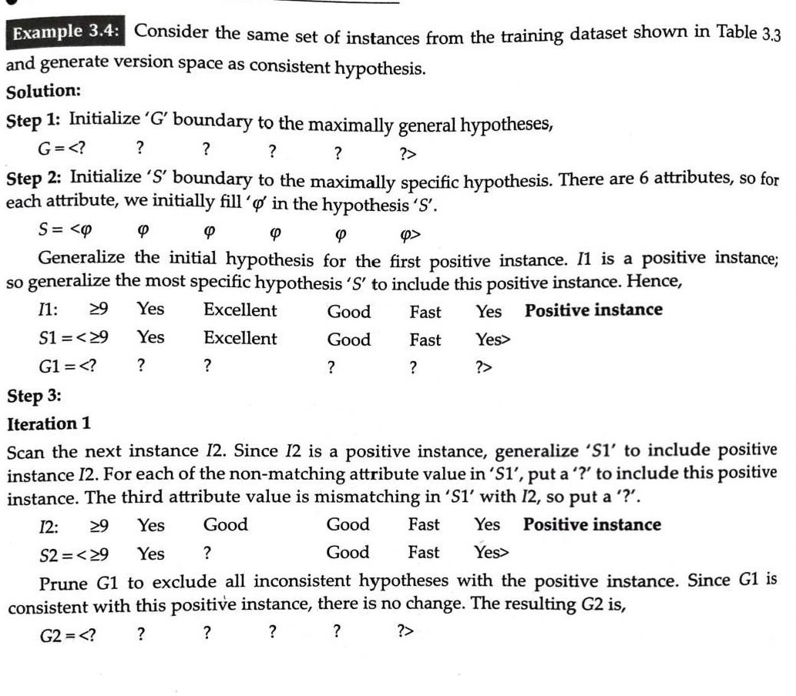

Slide 30
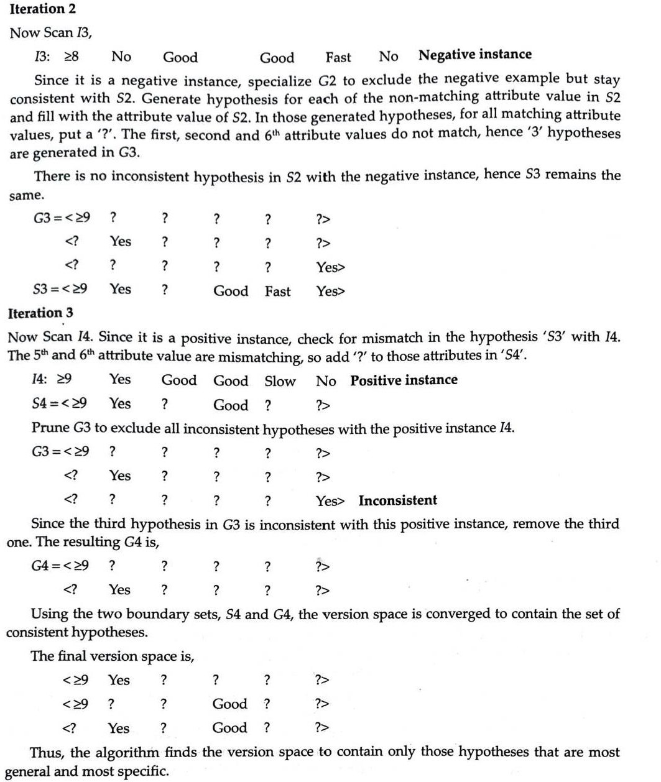

Slide 31
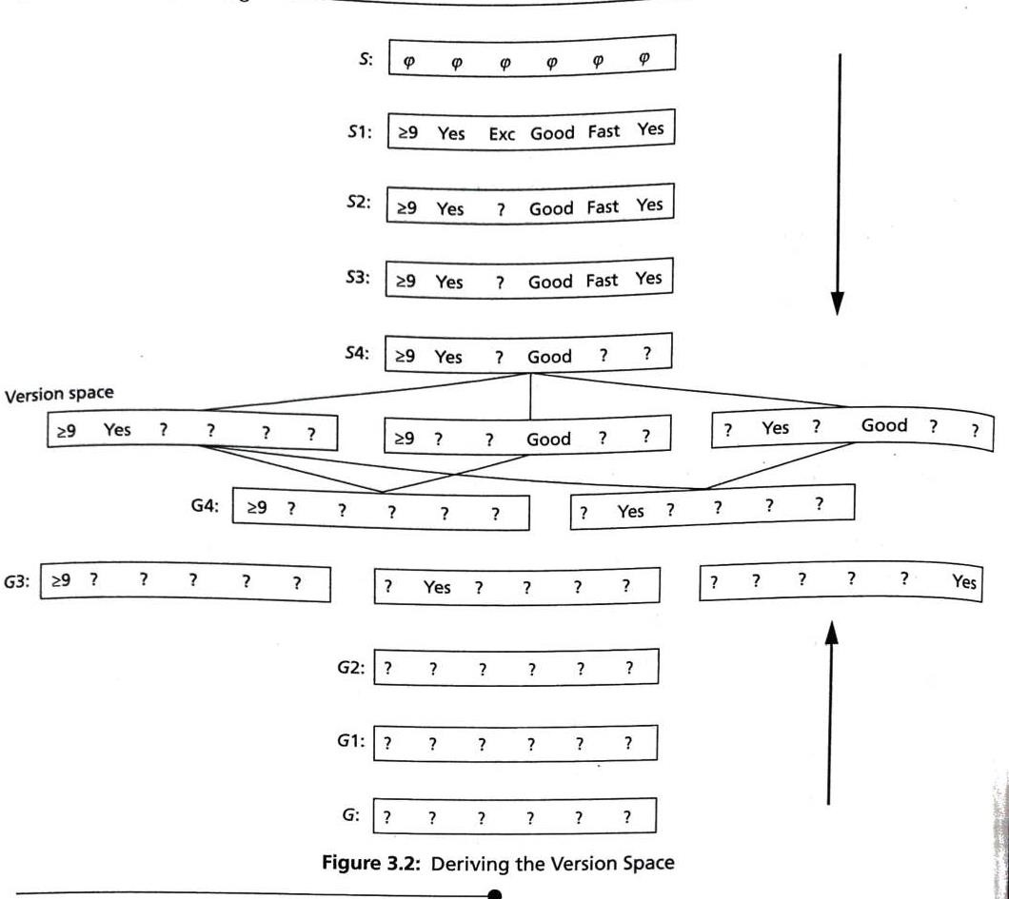

Slide 32
#LAB3 CANDIDATE ELIMINATION
import csv
with open("trainingexamples.csv") as f: csv_file = csv.reader(f)
data = list(csv_file) specific = data[0][:-1]
general = [['?' for i in range(len(specific))] for j in range(len(specific))]
step=1 #for printing purpose for i in data:
if i[-1] == "Y":
for j in range(len(specific)): if i[j] != specific[j]:
specific[j] = "?"
general[j][j] = "?"
elif i[-1] == "N":
for j in range(len(specific)): if i[j] != specific[j]:
general[j][j] = specific[j] else:
general[j][j] = "?"
print("\nStep {} of candidate elimination algo".format(step)) step+=1
print(specific) print(general)

Slide 33
gh = [] # gh = general Hypothesis for i in general:
for j in i:
if j != '?':
gh.append(i) break
print("\nFinal Specific hypothesis:\n", specific)
print("\nFinal General hypothesis:\n", gh)

Slide 34
Step 1 of candidate elimination algo
['sunny', 'warm', 'normal', 'strong', 'warm', 'same']
'?', '?', '?', '?']]
Step 2 of candidate elimination algo
['sunny', 'warm', '?', 'strong', 'warm', 'same']
'?', '?', '?', '?']]
Step 3 of candidate elimination algo
['sunny', 'warm', '?', 'strong', 'warm', 'same']
[['sunny', '?', '?', '?', '?', '?'], ['?', 'warm', '?', '?', '?', '?'], ['?', '?',
'?', '?', '?', '?'], ['?', '?', '?', '?', '?', '?'], ['?', '?', '?', '?', '?', '?'], ['?', '?', '?', '?', '?', 'same']]
Step 4 of candidate elimination algo
['sunny', 'warm', '?', 'strong', '?', '?'] [['sunny', '?', '?', '?', '?', '?'], ['?',
'warm', '?', '?', '?', '?'], ['?', '?', '?', '?', '?', '?'], ['?', '?', '?', '?',
'?', '?'], ['?', '?', '?', '?', '?', '?'], ['?', '?', '?', '?', '?', '?']]
Final Specific hypothesis:
['sunny', 'warm', '?', 'strong', '?', '?']
Final General hypothesis: [['sunny', '?', '?', '?', '?', '?'], ['?', 'warm', '?', '?', '?', '?']]
[['?', '?', '?', '?', '?', '?'], ['?', '?', '?', | '?', | '?', | '?'], ['?', '?', '?', | '?',
'?', '?'], ['?', '?', '?', '?', '?', '?'], ['?', | '?', | '?', | '?', '?', '?'], ['?', | '?',
[['?', '?', '?', '?', '?', '?'], ['?', '?', '?', | '?', | '?', | '?'], ['?', '?', '?', | '?',
'?', '?'], ['?', '?', '?', '?', '?', '?'], ['?', | '?', | '?', | '?', '?', '?'], ['?', | '?',

Slide 35
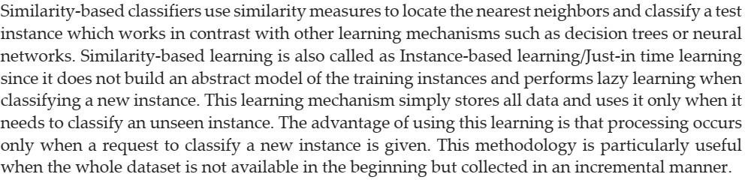
CHAPTER 4 SIMILARITY BASED LEARNING

Slide 36
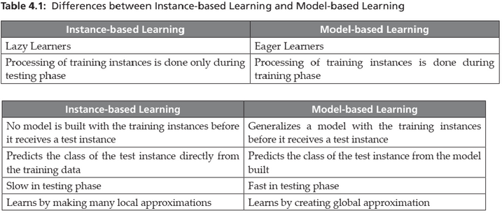

Slide 37
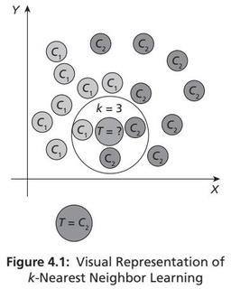
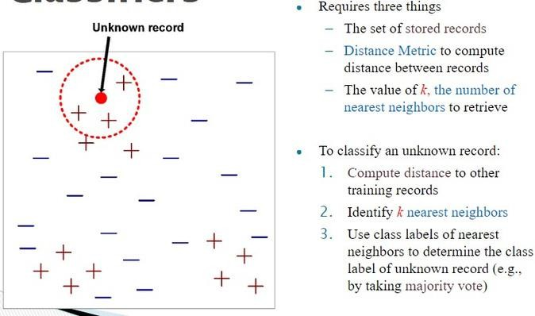

Slide 38
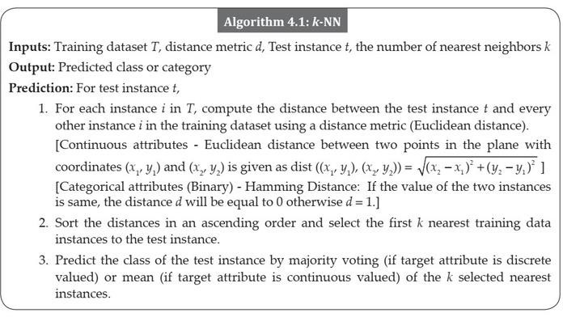
Algorithm 4.1: k-NN

Slide 39
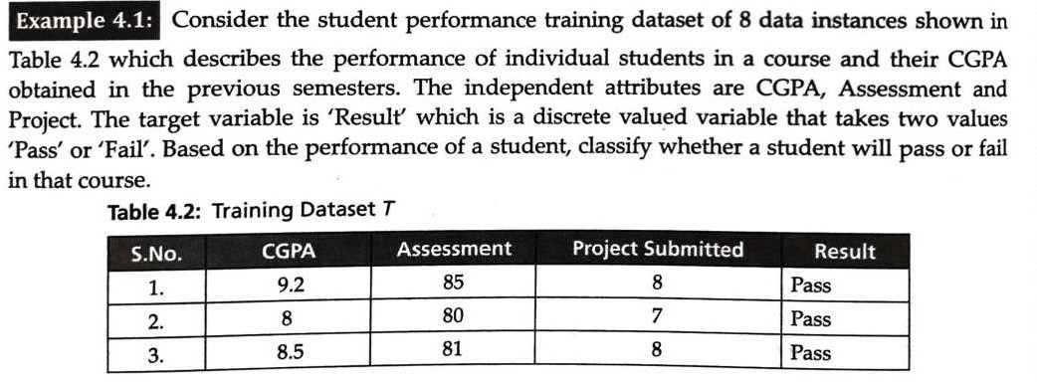
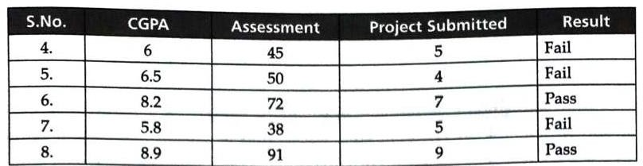

Slide 40
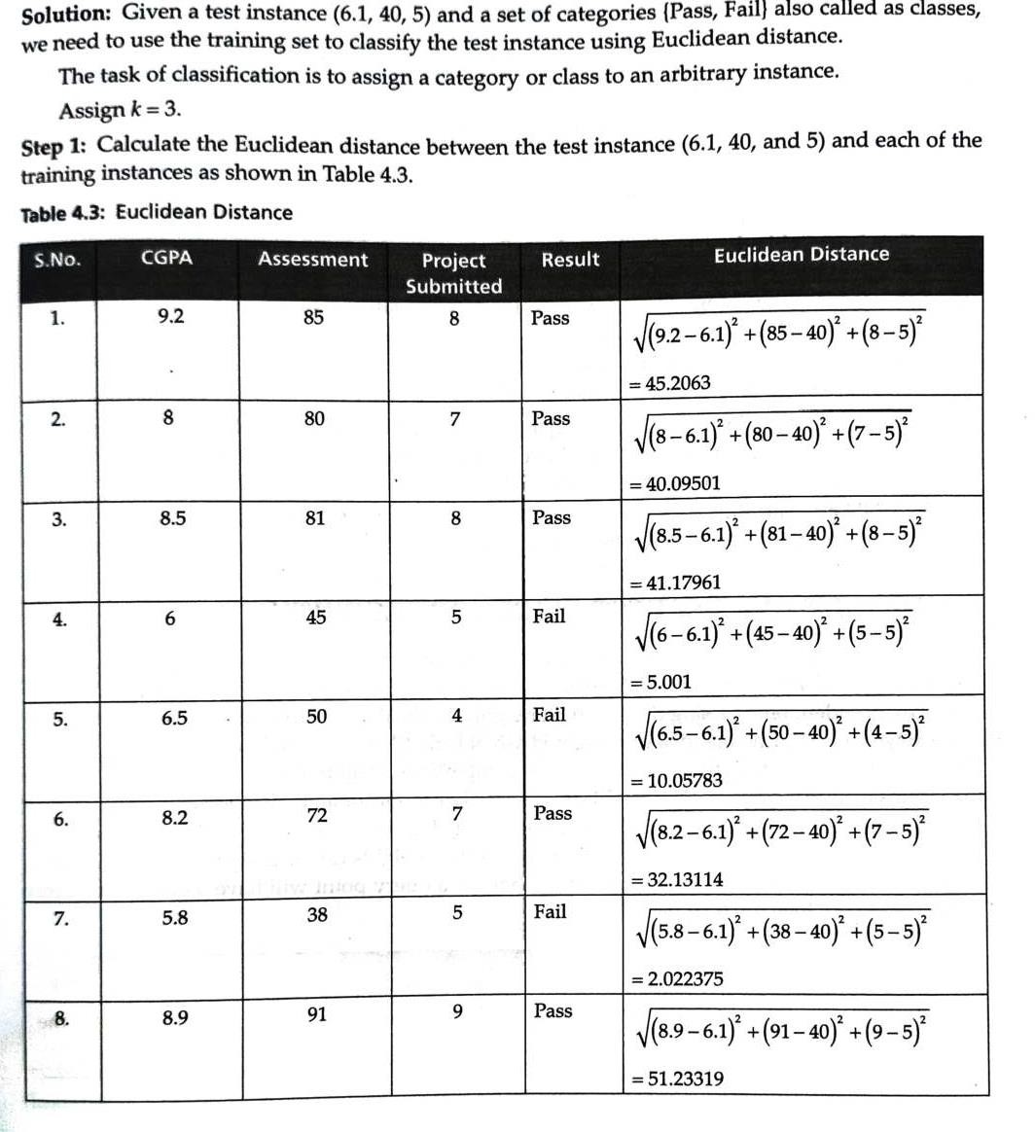

Slide 41
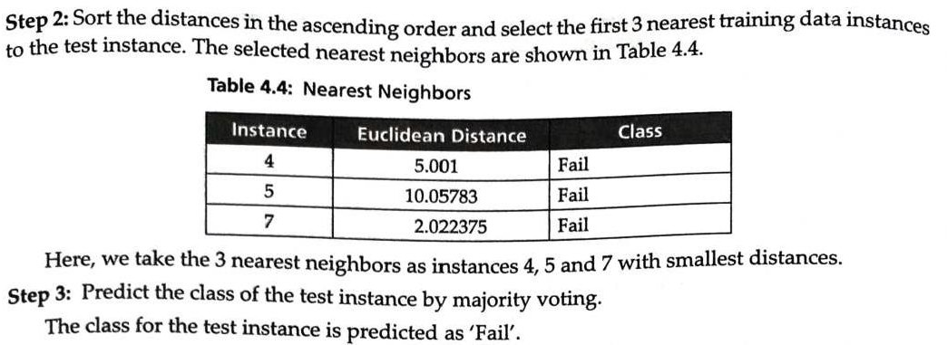

Slide 42
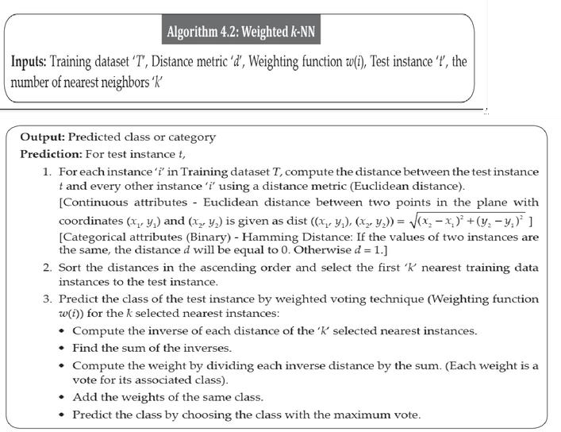
4.3 Weighted k-Nearest-Neighbor Algorithm

Slide 43
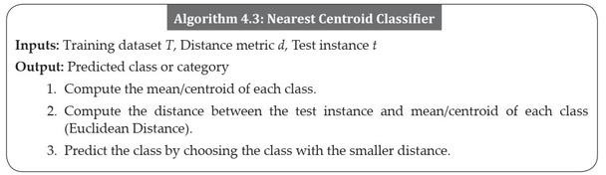
4.4 Nearest Centroid Classifier

Slide 44
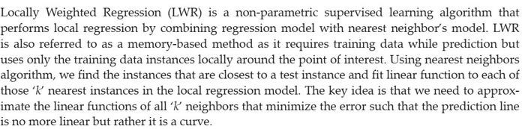
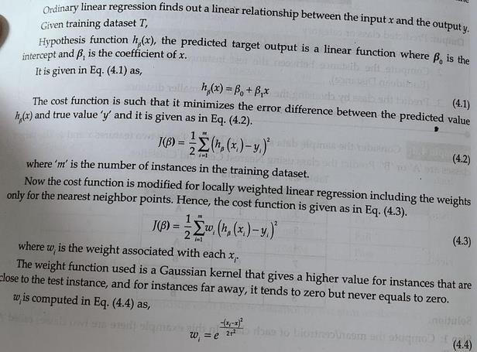
4.5 Locally Weighted Regression (LWR)

Slide 45
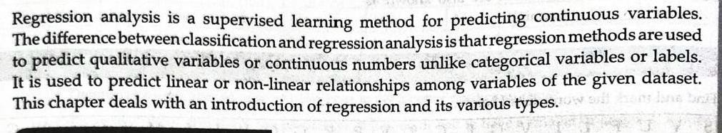
Chapter -5 Regression Analysis

Slide 46
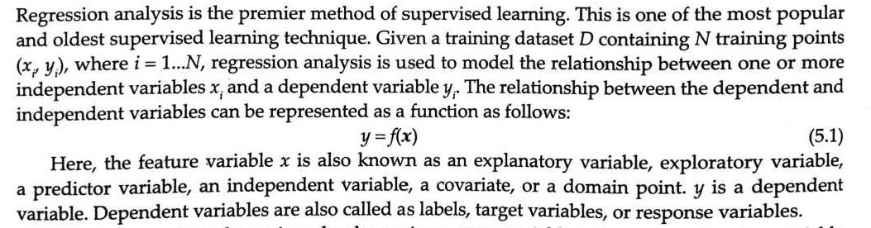

Slide 47
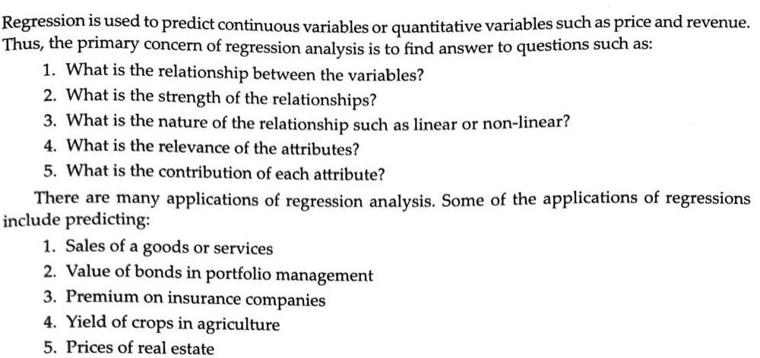

Slide 48


Introduction to Linearity ,Correlation, Causation

Slide 49


Slide 50


Slide 51


Slide 52


Slide 53


Slide 54


Slide 55


Slide 56


Slide 57


Slide 58


Slide 59


Slide 60


Slide 61


Slide 62


Slide 63


Slide 64


Slide 65


Slide 66


Slide 67


Slide 68
import numpy as np
import matplotlib.pyplot as plt def local_regression(x0, X, Y, tau):
x0 = [1, x0]
X = [[1, i] for i in X] X = np.asarray(X)
xw = (X.T) * np.exp(np.sum((X - x0) ** 2, axis=1) / (-2 * tau**2)) beta = np.linalg.pinv(xw @ X) @ xw @ Y
beta=beta @ x0 return beta
def draw(tau):
prediction = [local_regression(x0, X, Y, tau) for x0 in domain] plt.plot(X, Y, 'o', color='black')
plt.plot(domain, prediction, color='red') plt.show()
X = np.linspace(-3, 3, num=1000)
domain = X
Y = np.log(np.abs(X ** 2 - 1) + .5) draw(10)
draw(0.1) draw(0.01) draw(0.001)

Slide 69


